Slide 1
Word Embeddings & Deep Learning - NLP
Aniket Chhabra

Slide 2
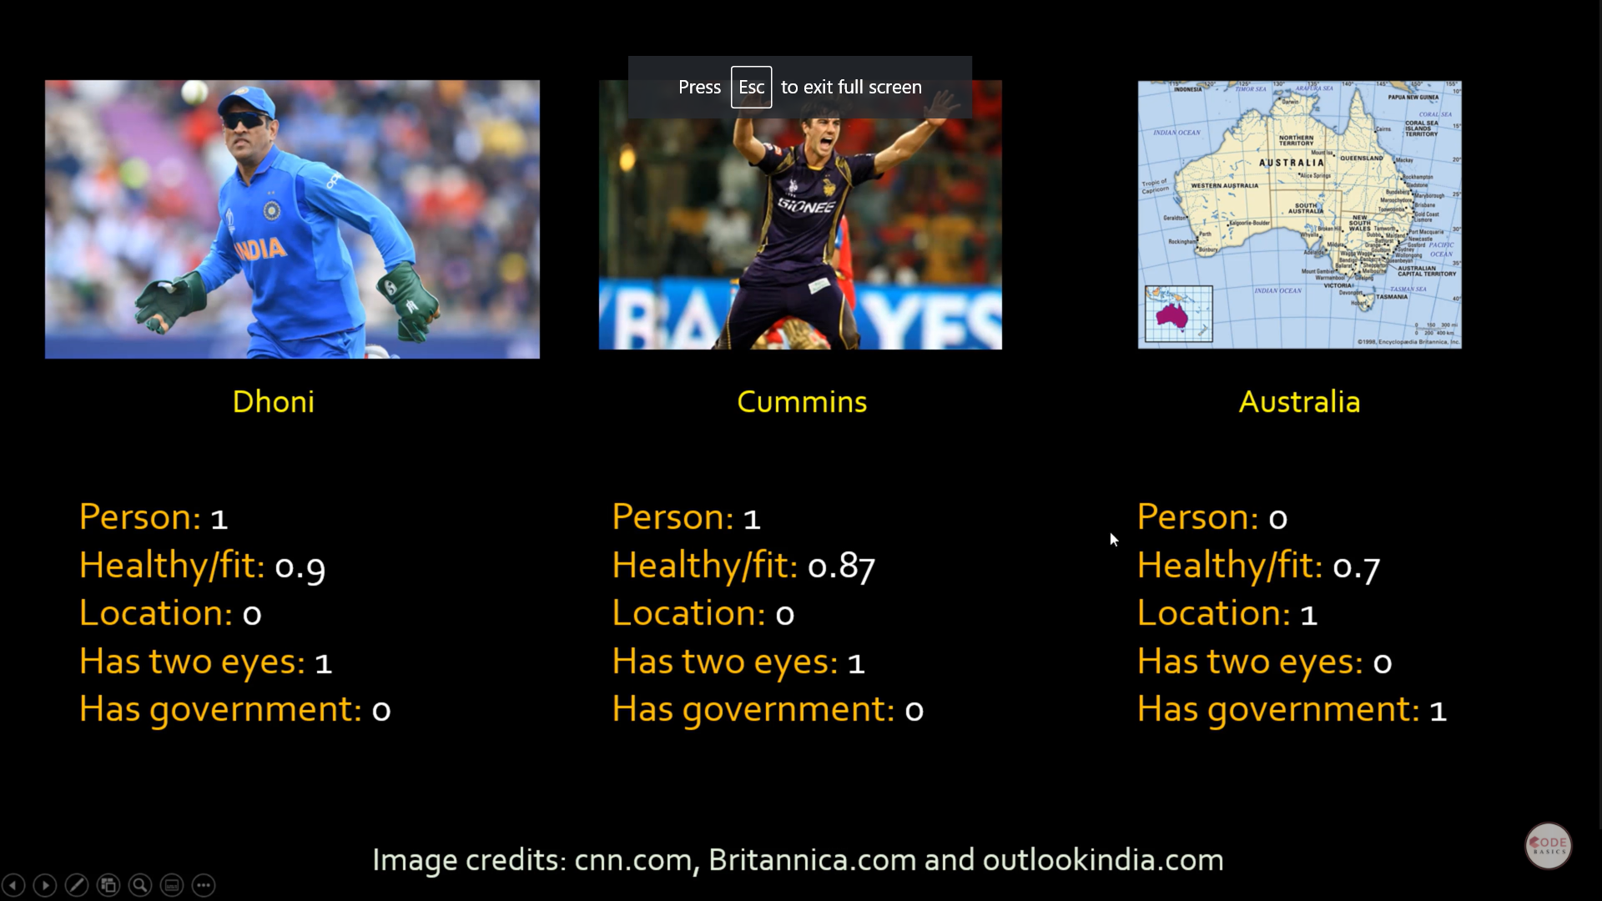

Slide 3
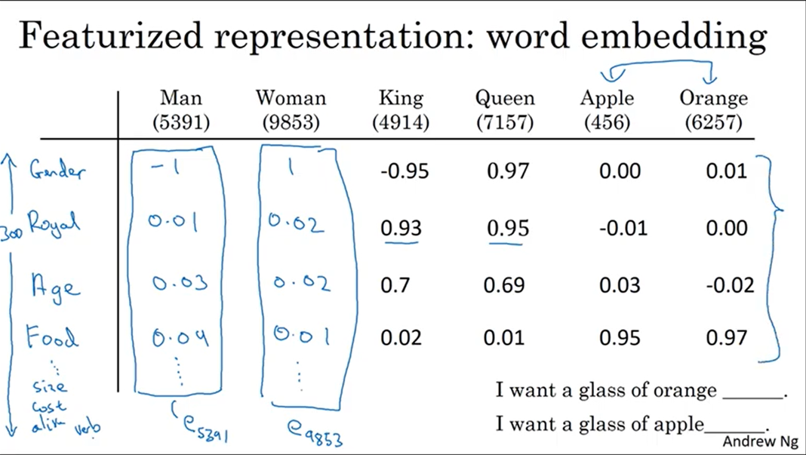

Word Embeddings – Feature representation of words
Man is a 300-dimensional vector in the input feature space
Now, Apple and orange looks similar, Cosine Similarity or Euclidean distance is also close. This helps algorithms to generalize better
But interpretation of each of the features or vectors here is not easy but in relative sense they are
Notes:
https://www.youtube.com/channel/UCMn3_305DqmTylxJPFA8OJA

Slide 4
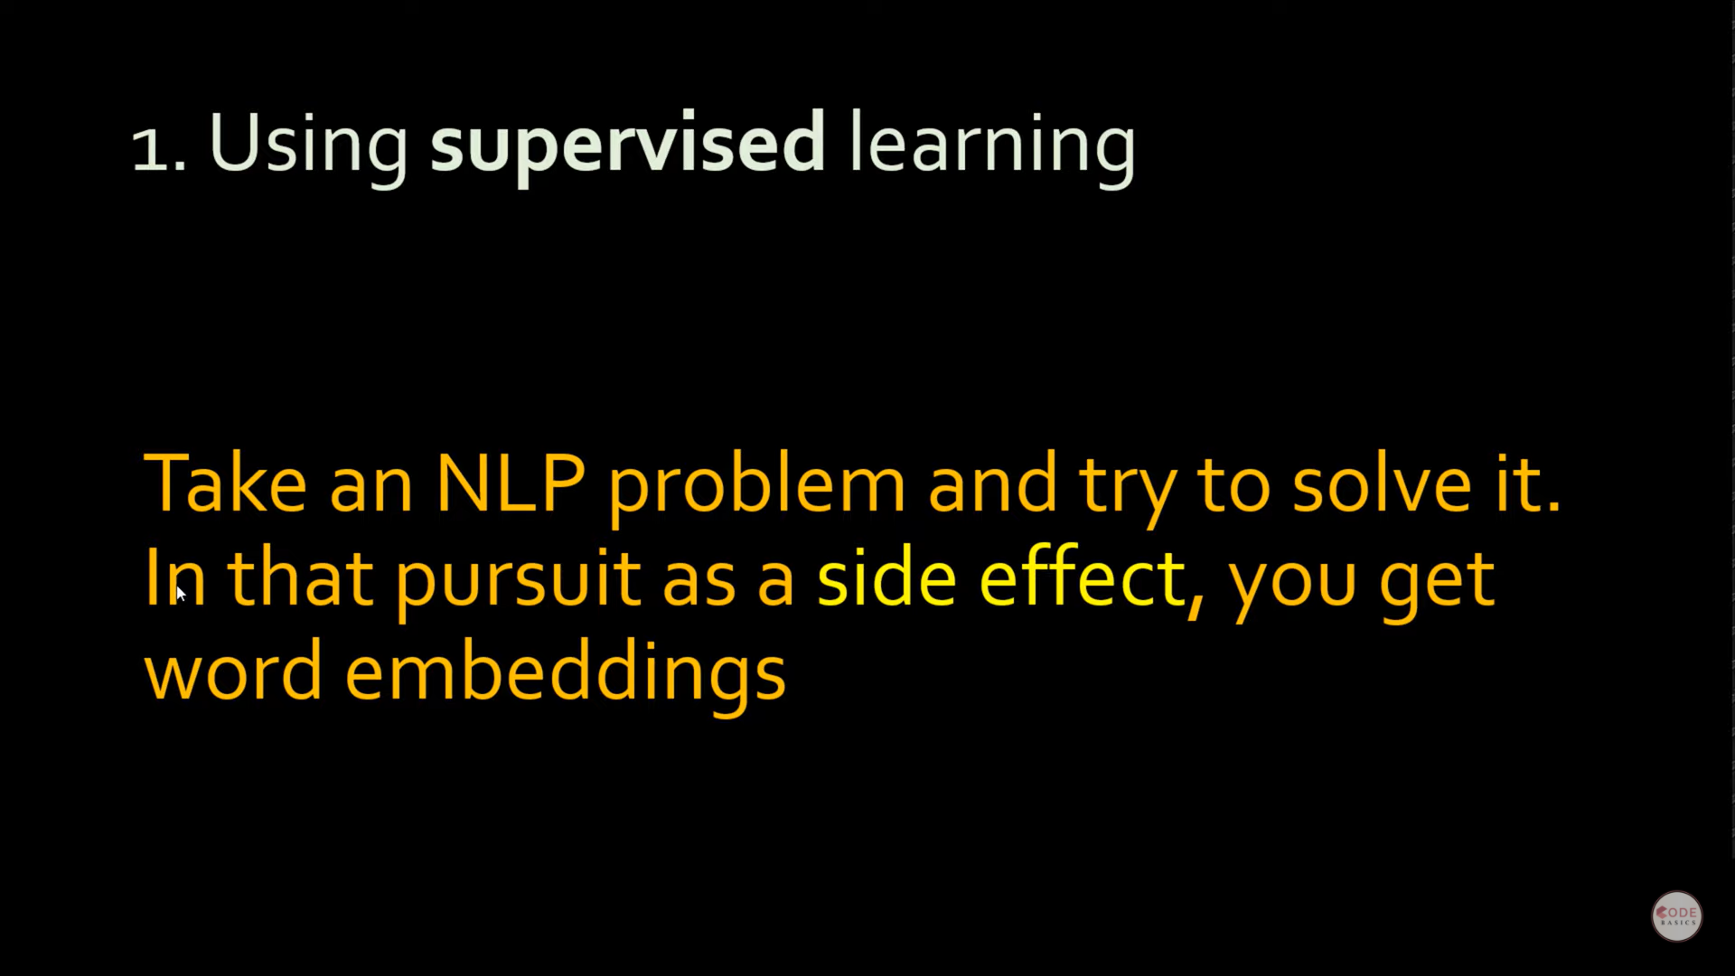
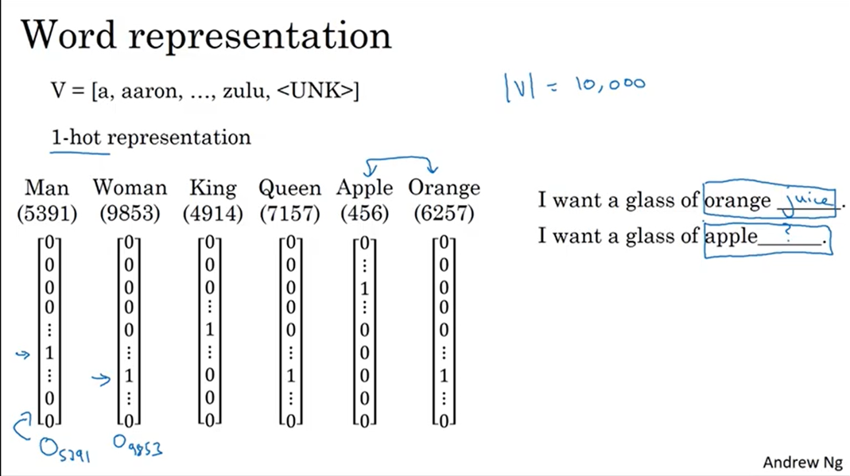
Word Embeddings – One Hot representation of words
Difficult to generalize the model from above since If we train a model on orange juice even then for apple juice (which is similar semantic meaning) we will have to follow the same process
Also, the product of Apple and orange (or any two vectors) above is 0
Notes:
https://www.youtube.com/channel/UCMn3_305DqmTylxJPFA8OJA
One-Hot coding is simple and easy to use, the disadvantages are also obvious:
The length of the word vector is equal to the length of the vocabulary, and the word vector is extremely sparse. When the vocabulary is large, the computational complexity will be very large.
Any two words are orthogonal, meaning that the relationship between words cannot be obtained from the One-Hot code
The distance between any two words is equal, and the semantic relevance of the two words cannot be reflected from the distance

Slide 5
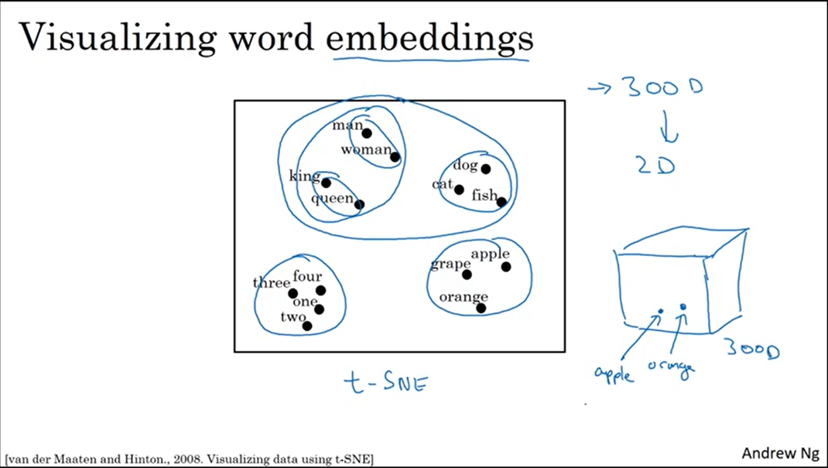
Word Embeddings – Feature representation of words
The each of the vector is called embeddings since they are embedded into a 300-dimensional vector space
Notes:
https://www.youtube.com/channel/UCMn3_305DqmTylxJPFA8OJA

Slide 6
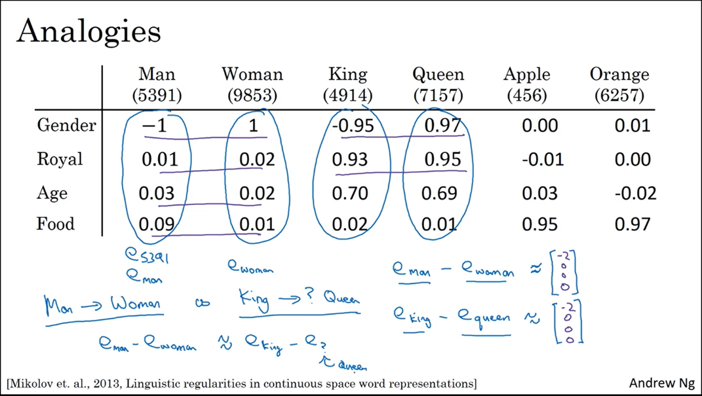
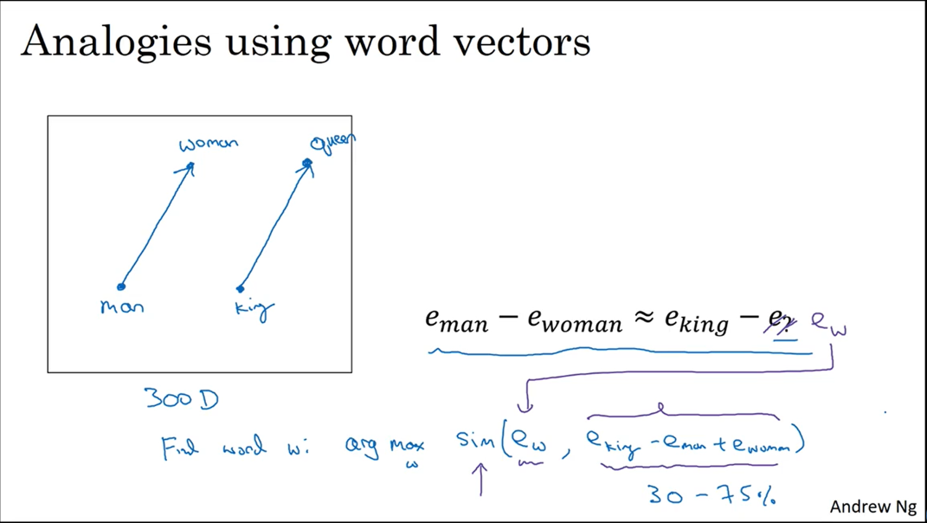
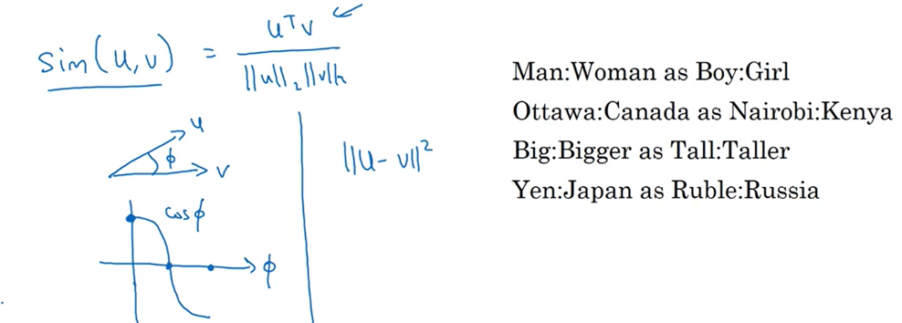
Word Embeddings – How do we see semantic relationship Properties (Analogies using word vec)
Left side equal to right side – If man – woman then king – what?? (difference in gender)
Algorithm – Similarity/distance
Notes:
https://www.youtube.com/channel/UCMn3_305DqmTylxJPFA8OJA

Slide 7
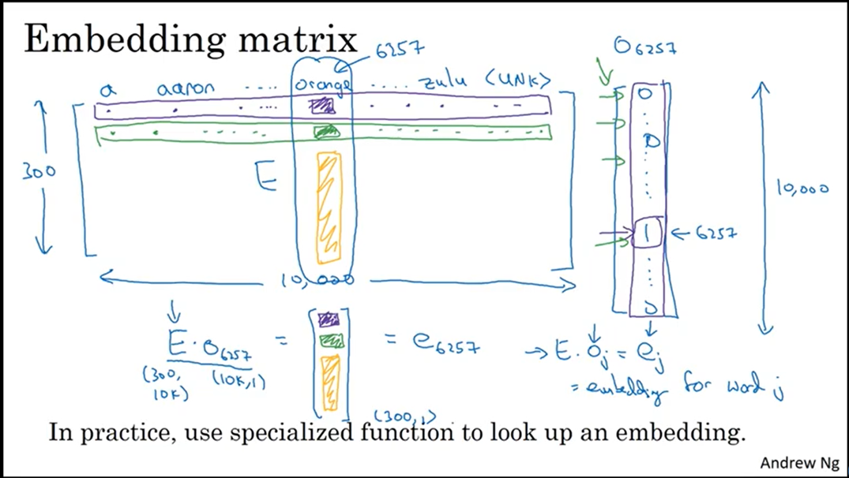




Word Embeddings – Embedding Matrix to Layer
Vocabulary Size – 10000 words (one of parameters in the model). We can choose any size of vocabulary
We use embedding function in Keras to do the matrix vector multiplication operation
Notes:
https://www.youtube.com/watch?v=VkjSaOZSZVs&list=PL1w8k37X_6L_s4ncq-swTBvKDWnRSrinI&index=19

Slide 8
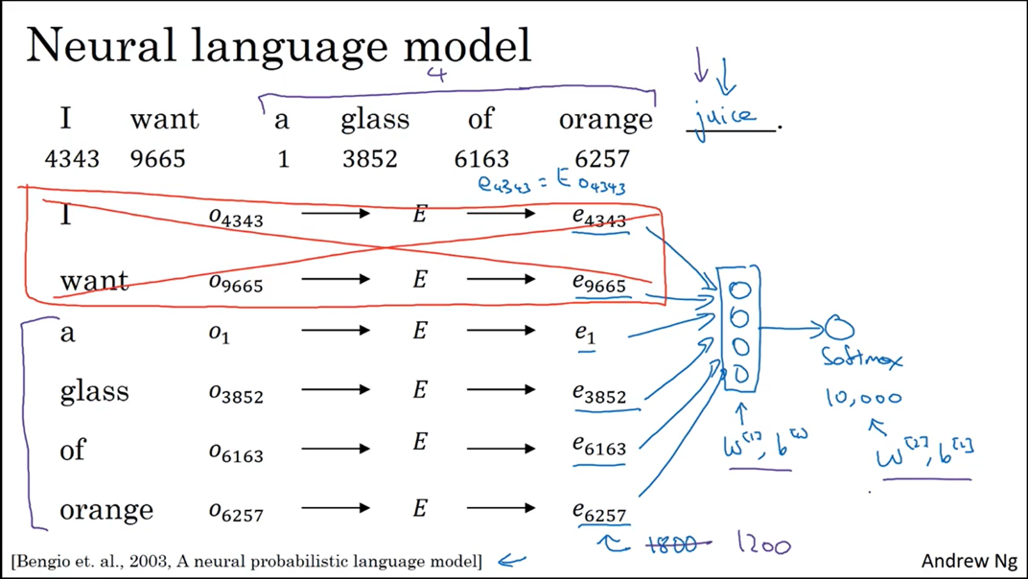




Word Embeddings – Neural Language Model Framework
Neural Network Structure:-
Input layer - Embedding layers (300,1 each input – stacked together)
Output layer – Probability of each of word using a softmax activation (multiclass prediction)
*In output layer, highest prob value is final prediction for the word like ‘Juice’
We use embedding size in Keras Embedding layer to decide the matrix size
Notes:
https://www.youtube.com/watch?v=xtPXjvwCt64&list=PL1w8k37X_6L_s4ncq-swTBvKDWnRSrinI&index=22

Slide 9
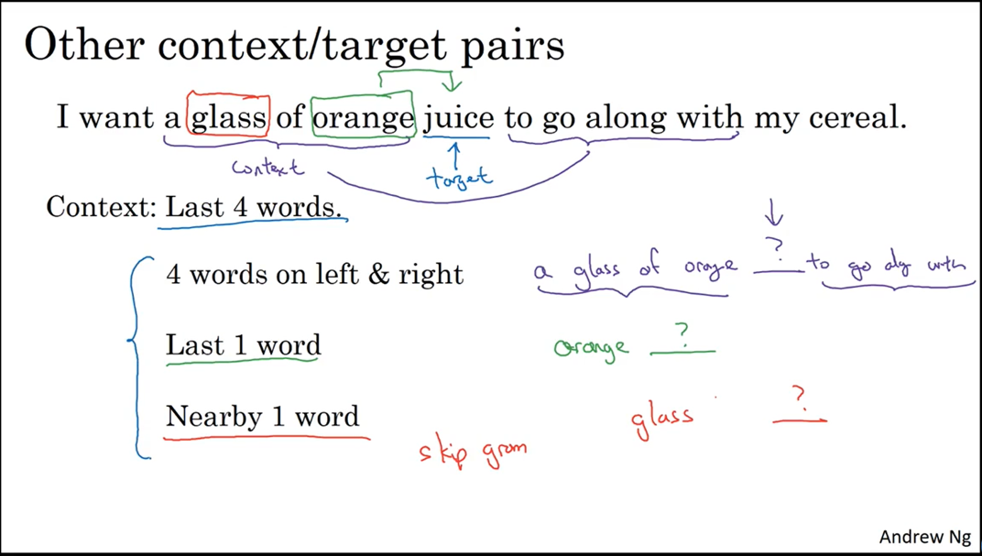
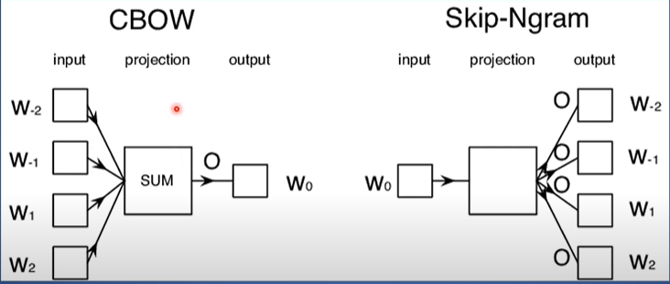
Word Embeddings – Word2vec models introduction
Using the context from previous or post words – Sliding window (parameter) concept
Notes:
https://www.youtube.com/watch?v=VkjSaOZSZVs&list=PL1w8k37X_6L_s4ncq-swTBvKDWnRSrinI&index=19

Slide 10
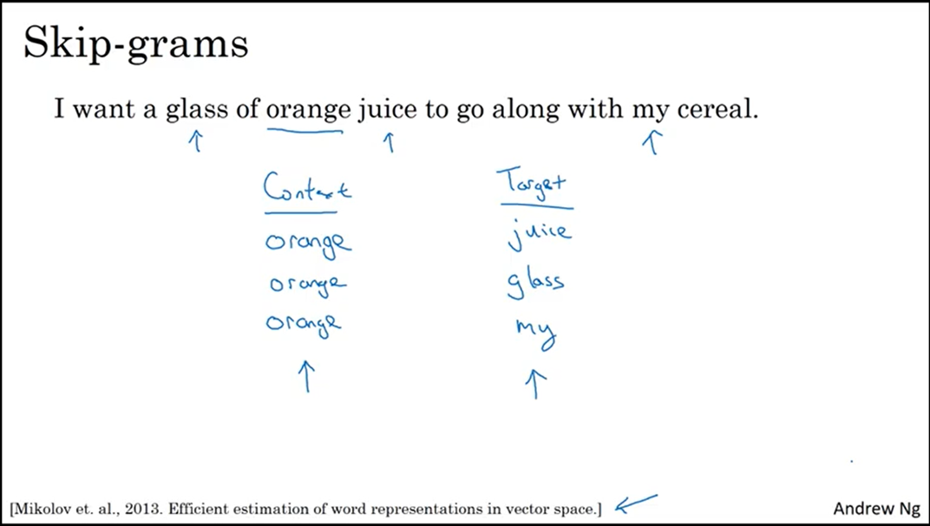
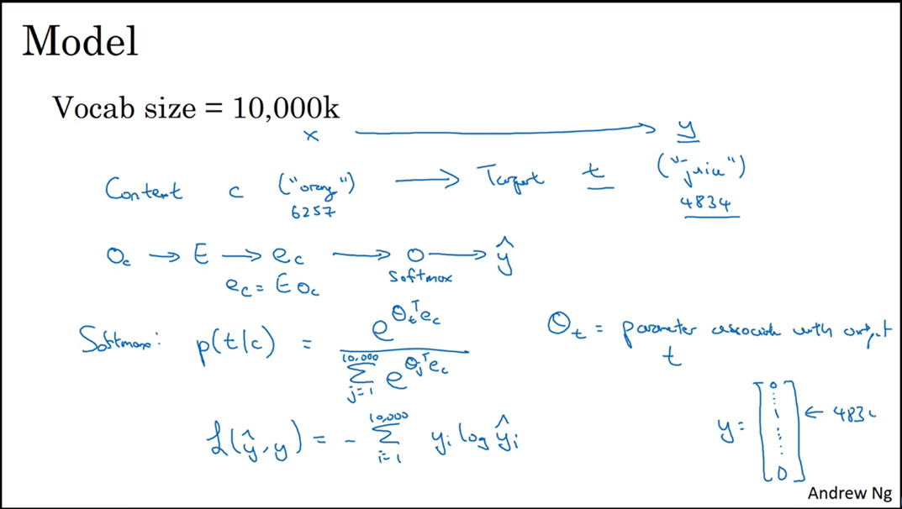
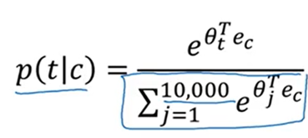
Word2vec – Skip-gram model Contd…
Randomly pick a context word like – orange
Now, we pick randomly a word within close vicinity of context word (sliding window) and it will be the Target word like – by chance we pick the word – juice or glass or the word my
So, here we are fitting a supervised learning algo where given the context word we are predicting target word within suppose +- 5 words window (neighborhood of the word – orange) – Next page image
Note - But we face computational challenges with softmax classification, - Negative sampling technique comes into play
Notes:
https://www.youtube.com/watch?v=jak0sKPoKu8&list=PL1w8k37X_6L_s4ncq-swTBvKDWnRSrinI&index=23

Slide 11
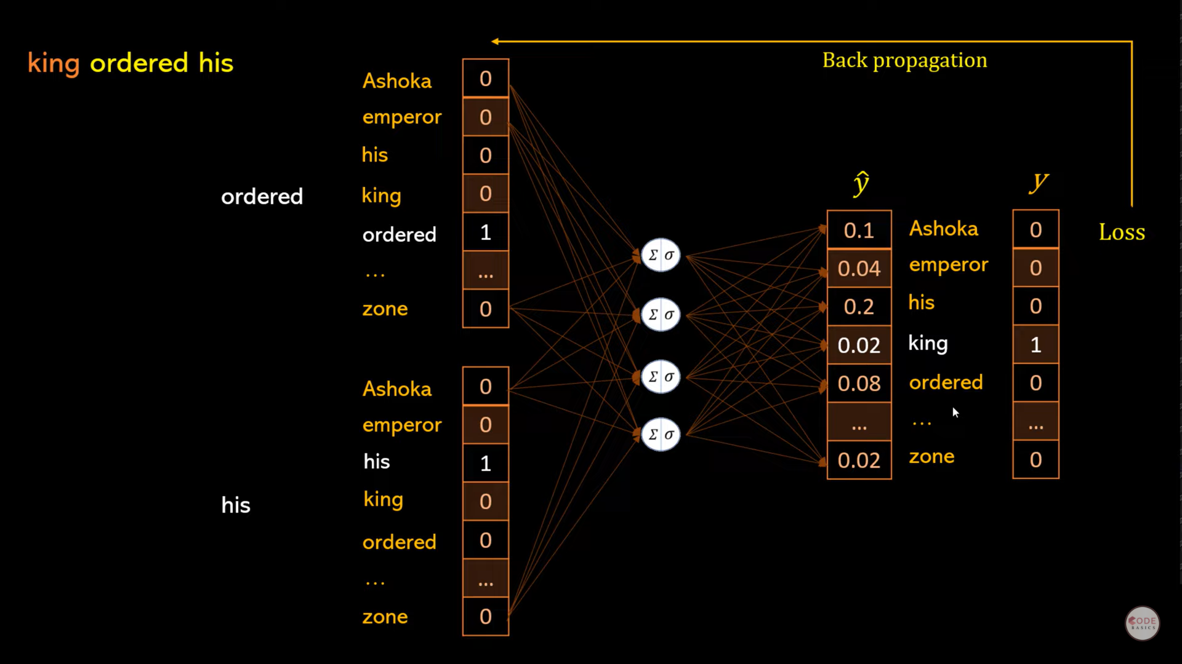

Slide 12
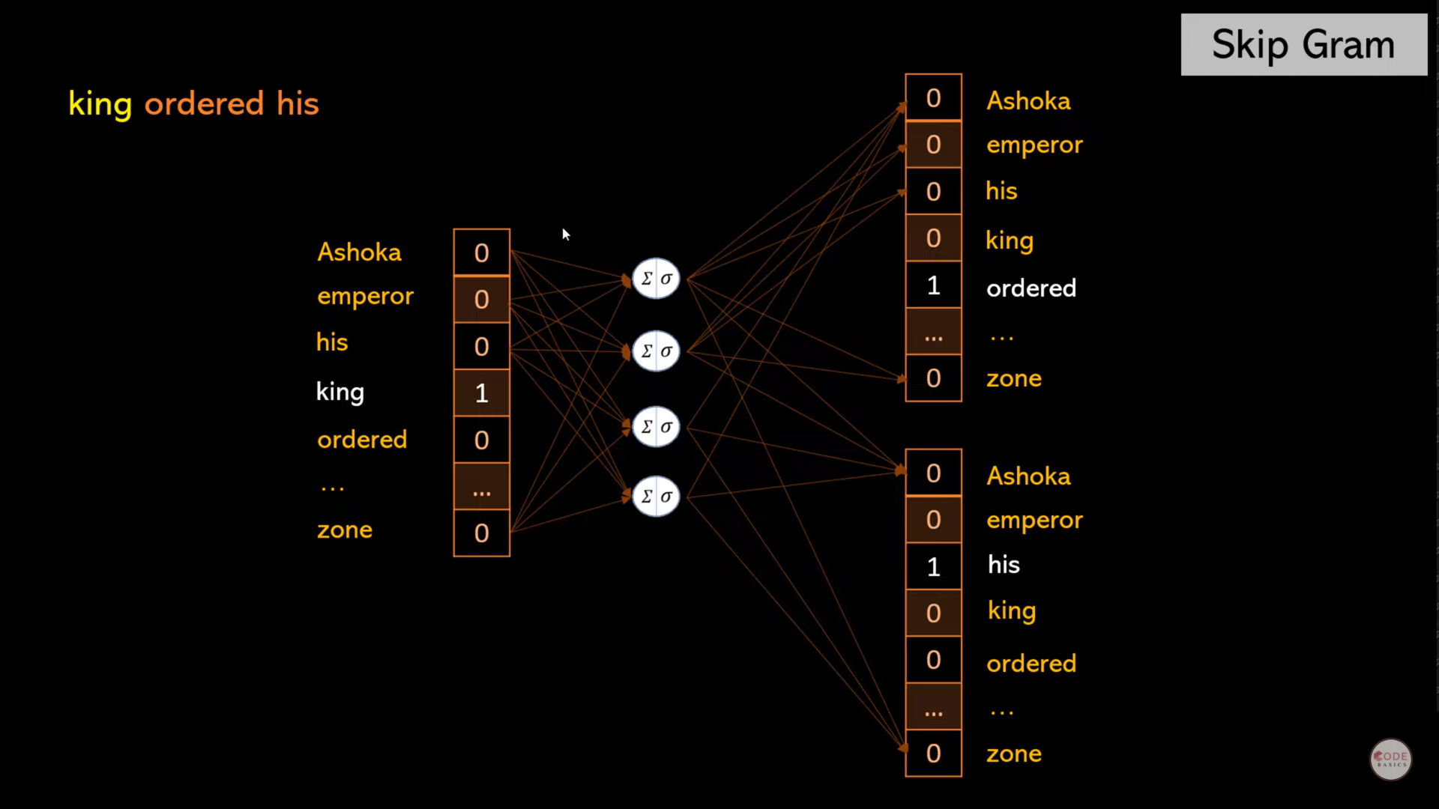

Slide 13
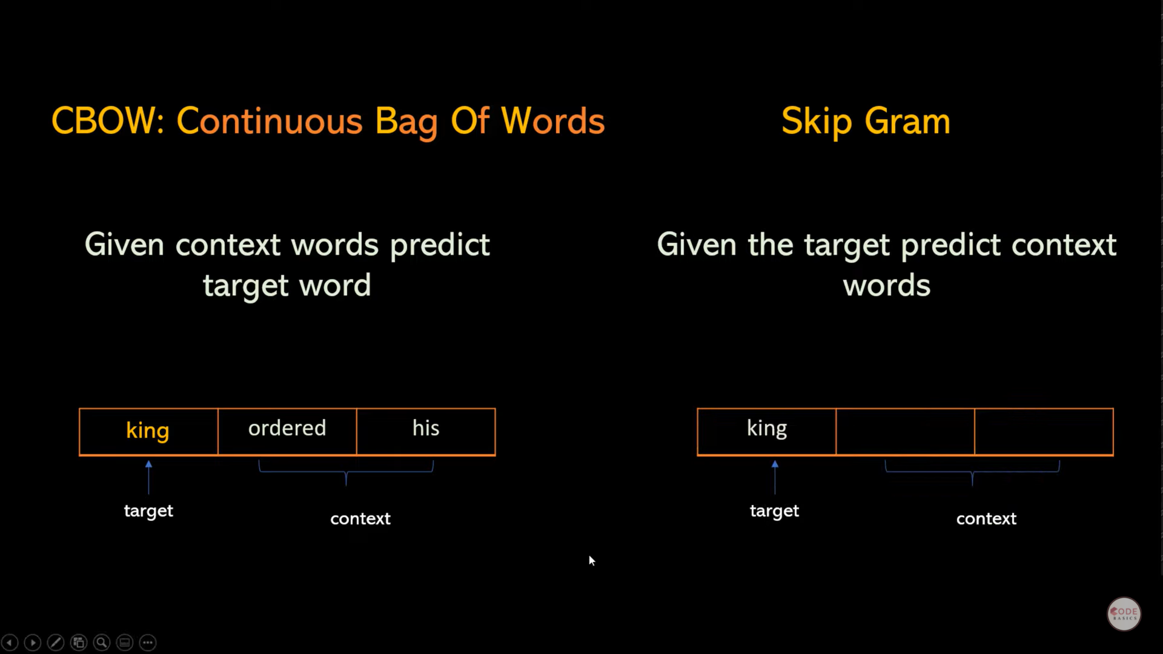

Slide 14
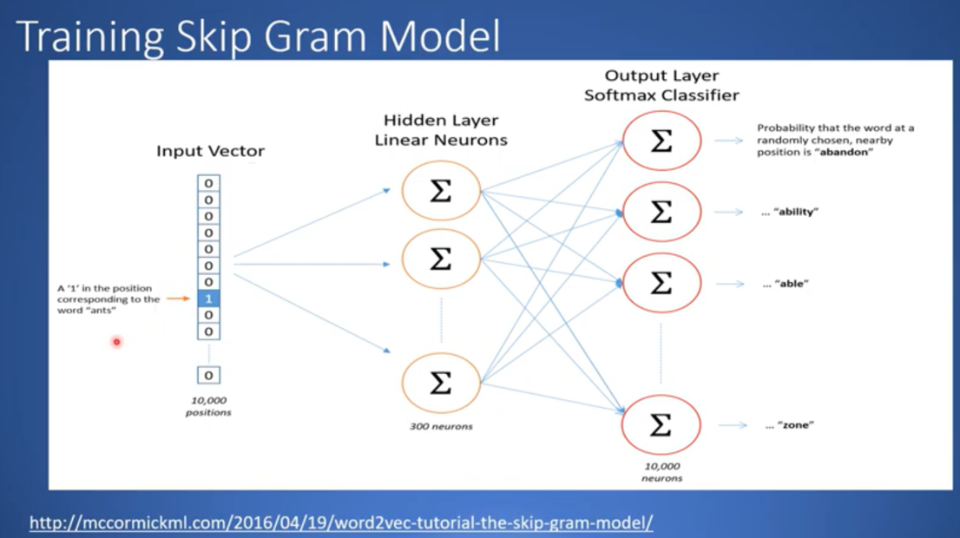

Slide 15
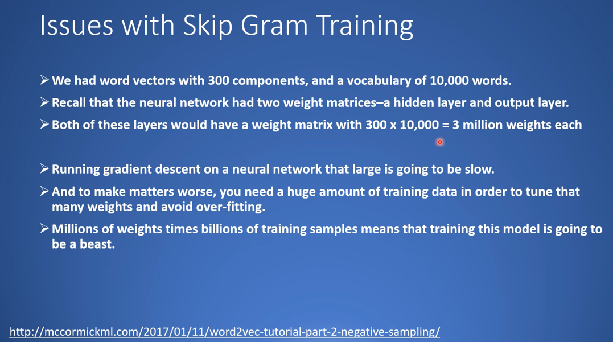

Slide 16
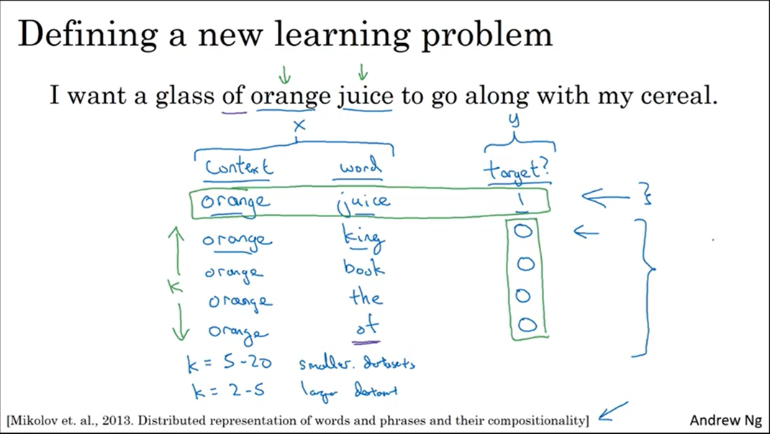
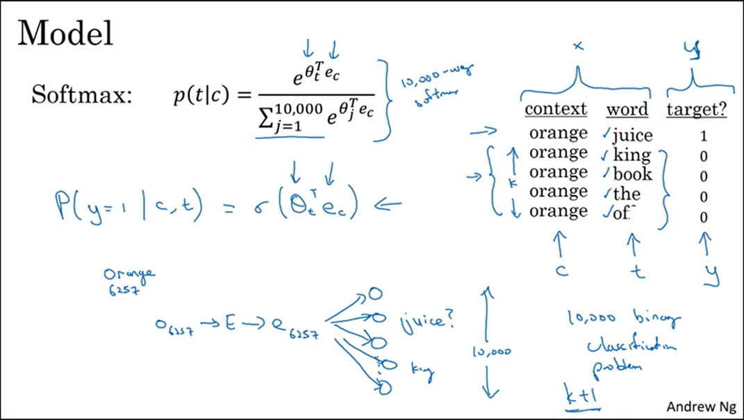
Word2vec – Negative Sampling Introduction
A new supervised learning algo with picking up a couple of sample pairs (context, target)
Generate with the same softmax highest probability and call it as a +ve example – orange, juice
Generate another sample pair but with picking a word randomly (with any prob) – orange, king and a couple of other pairs and label it as 0
The problem here is to solve that given the pair of words like – (orange, juice) What is probability that they will occur together? Training set is generated on the same
Now, instead of running 10K models (based on vocab size for each of the word) we run K+1 models (Spatial logistic Regression). For every iteration (no. of iterations we pick) we choose k different words and select with highest prob
Notes:
https://www.youtube.com/watch?v=VkjSaOZSZVs&list=PL1w8k37X_6L_s4ncq-swTBvKDWnRSrinI&index=19

Slide 17
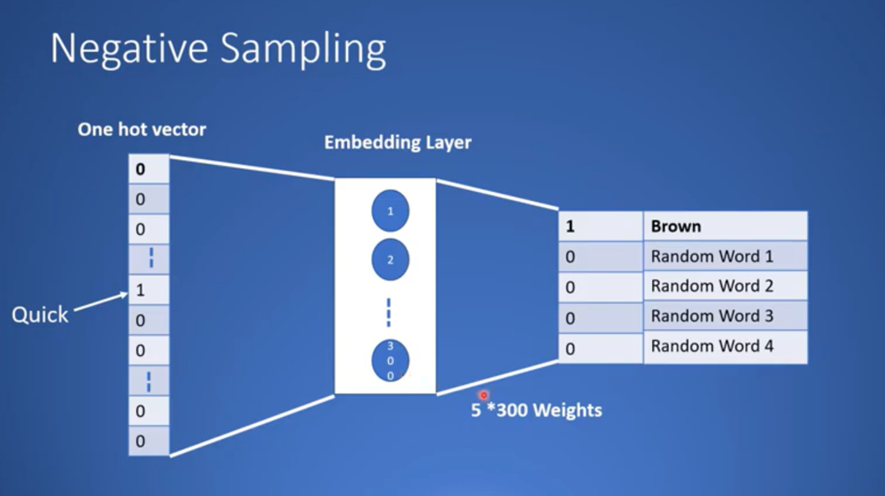



Juice
Orange

Slide 18
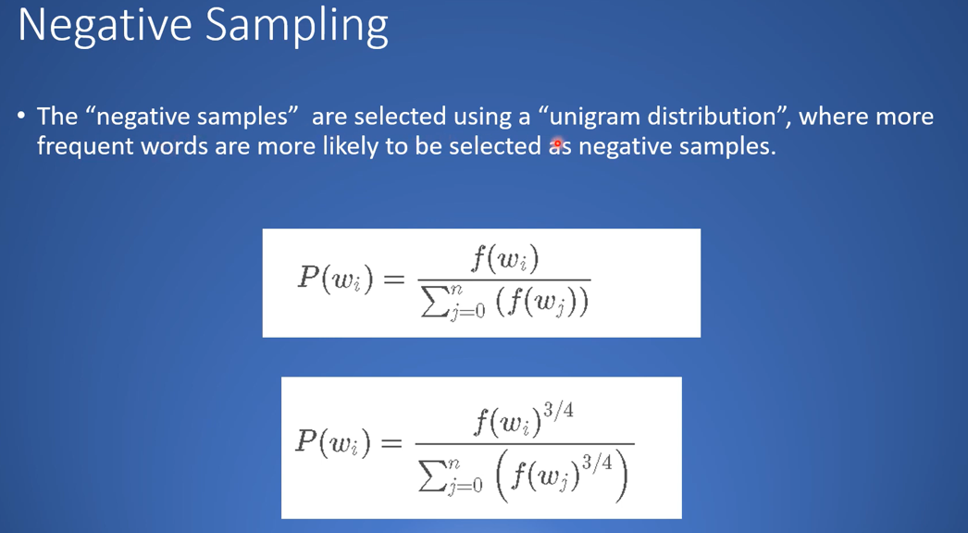

Slide 19
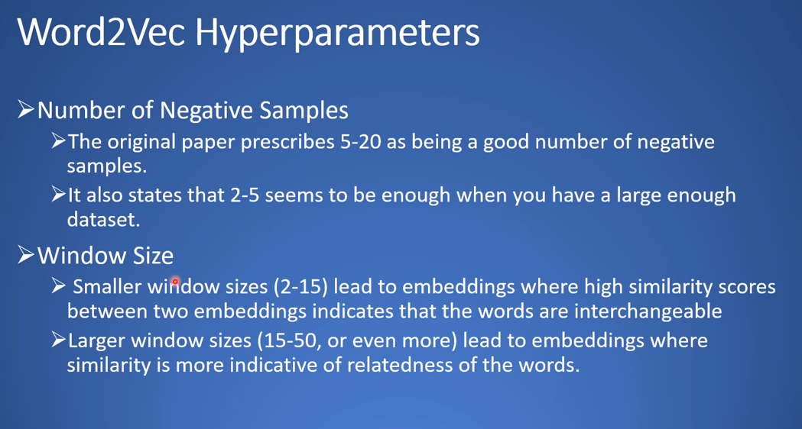

Slide 20
GloVe – Global Vectors

Slide 21
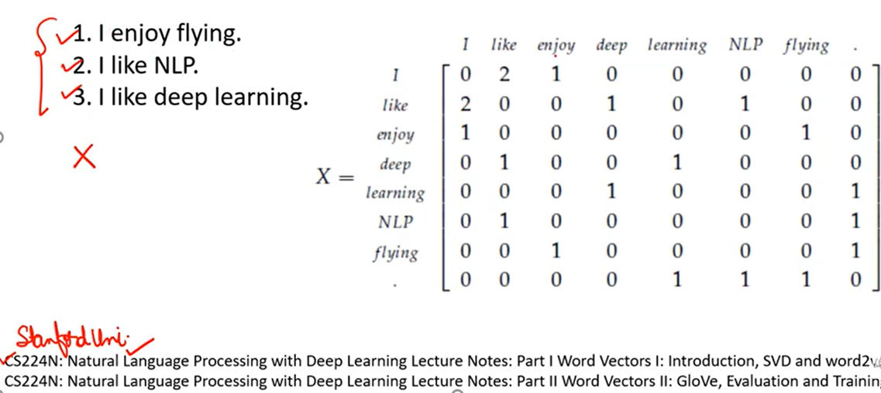



























GloVe – Word-word Co-occurrence Matrix

Slide 22
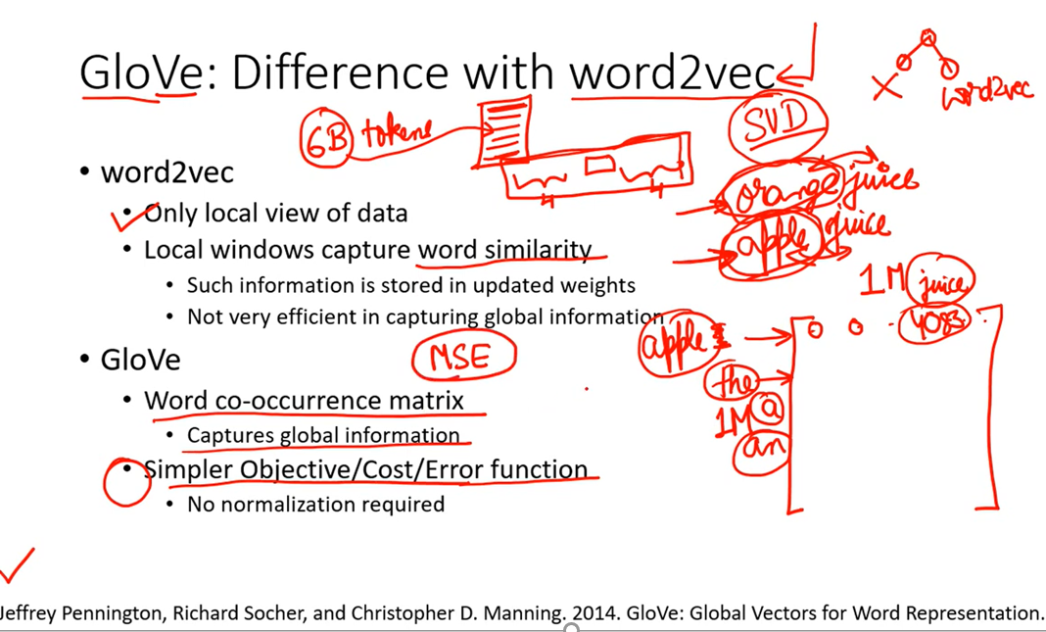





Word2Vec v/s GloVE

Slide 23
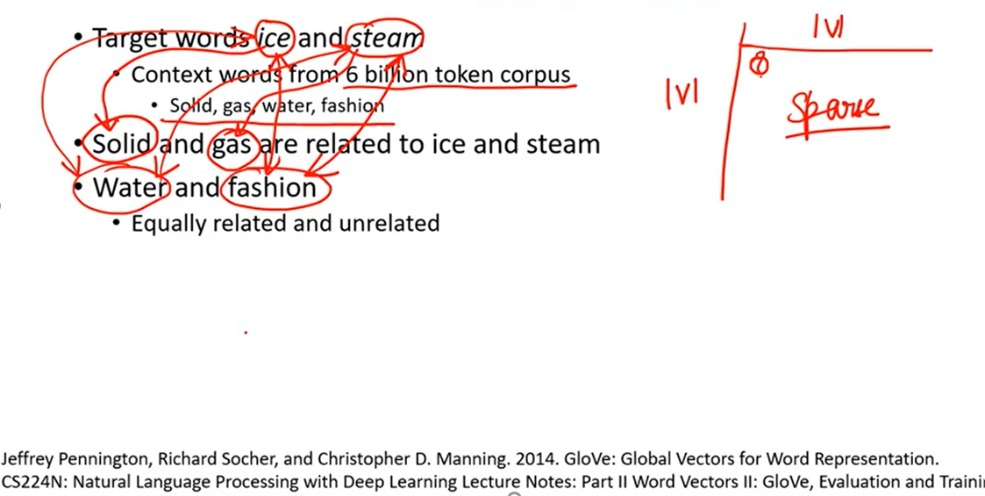
GloVe – Co-occurrence Probabilities Intuition

Slide 24
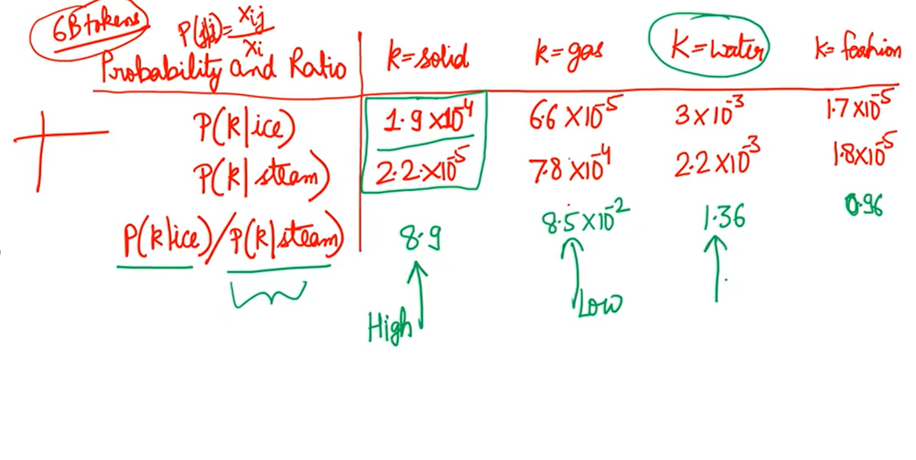
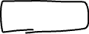

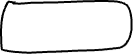





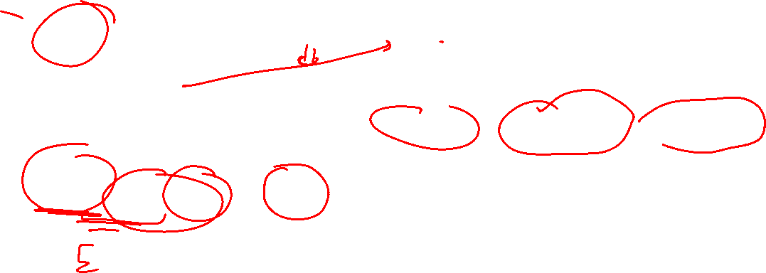








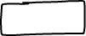
GloVe – Co-occurrence Probabilities Intuition

Slide 25
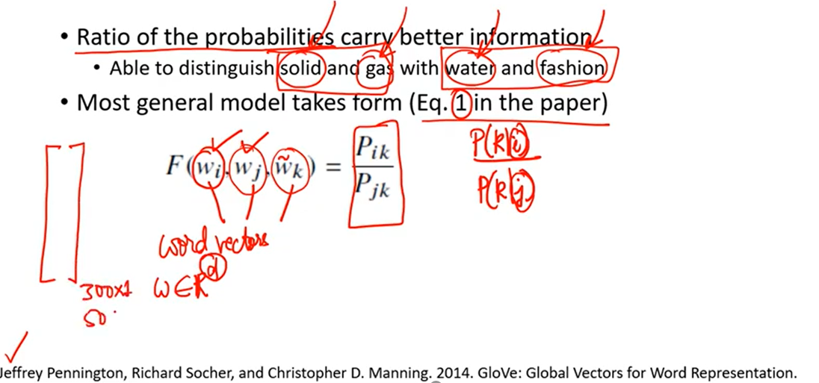

GloVe – Towards Cost Function

Slide 26
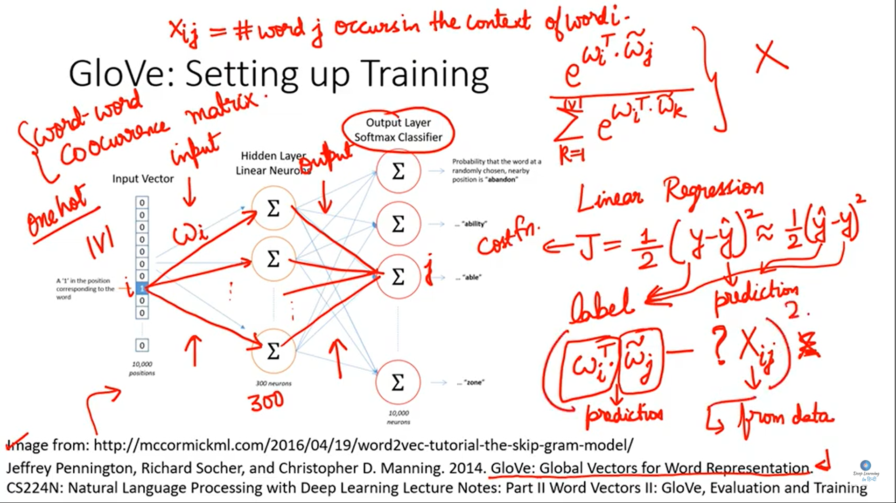
GloVe – Towards Cost Function

Slide 27
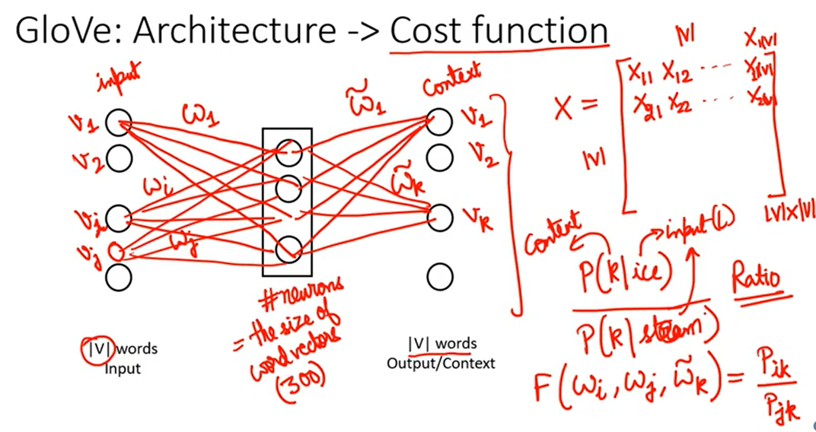
GloVe – Towards Cost Function

Slide 28
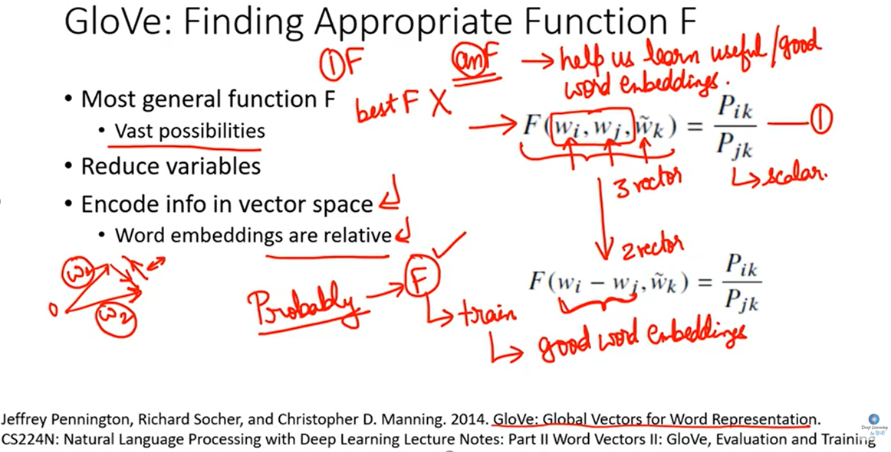
GloVe – Towards Cost Function Contd…

Slide 29
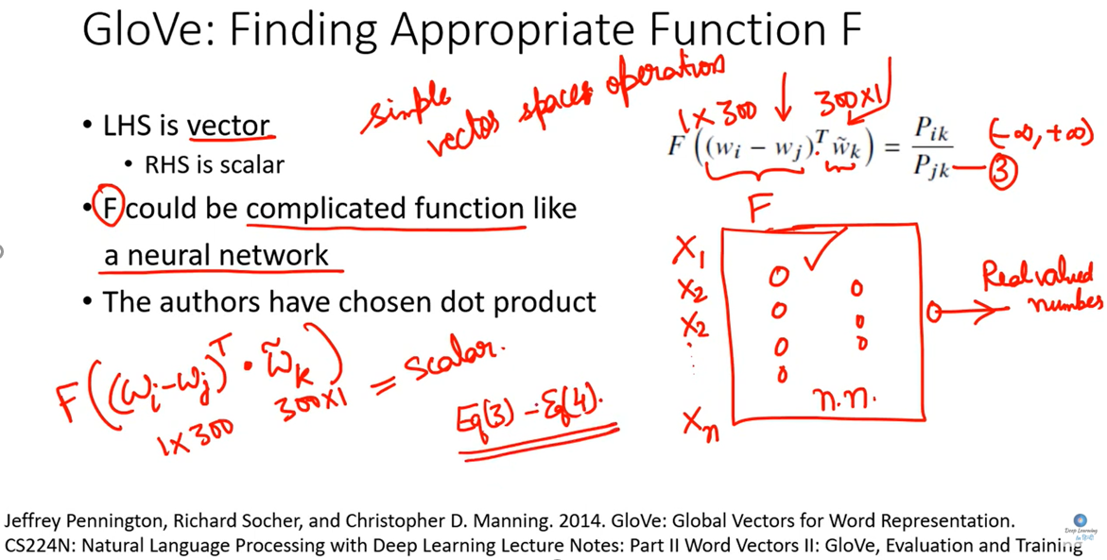
GloVe – Towards Cost Function Contd…

Slide 30
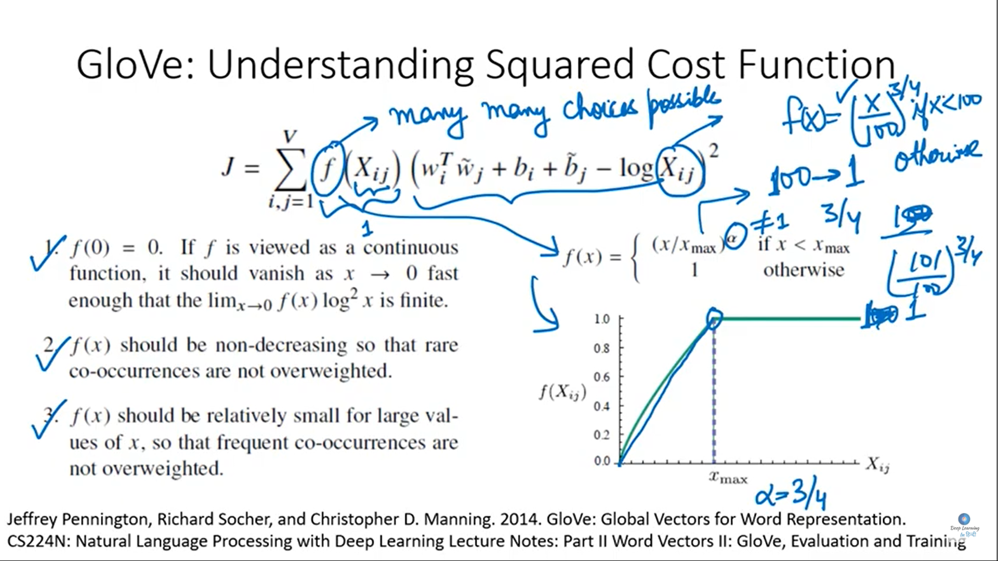

Slide 31
APPENDIX

Slide 32
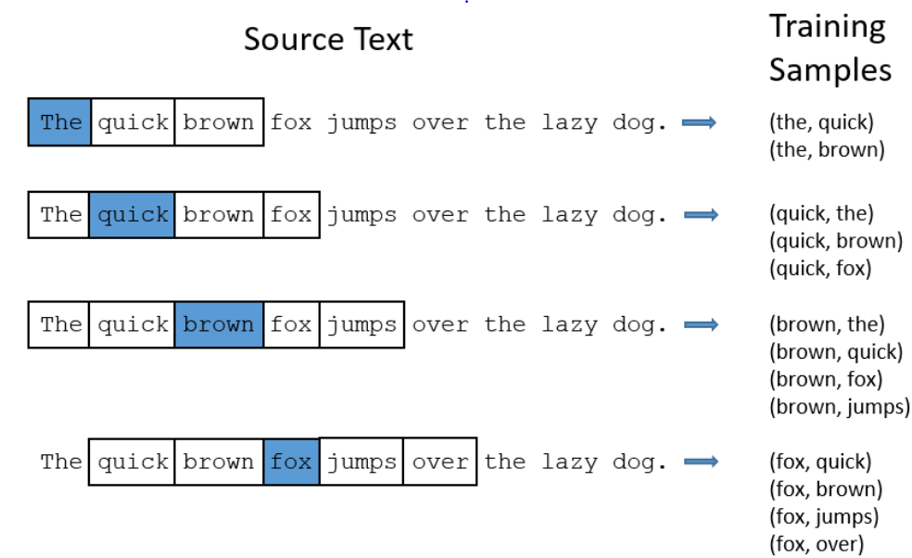
Word2vec – Skip-gram Model
Sliding window parameter
Notes:
https://www.youtube.com/watch?v=xtPXjvwCt64&list=PL1w8k37X_6L_s4ncq-swTBvKDWnRSrinI&index=22

